Slide 1
Classification and Regression Analysis of the Bank Marketing Dataset
MAYKEL KALTA
ID:501229519

Slide 2
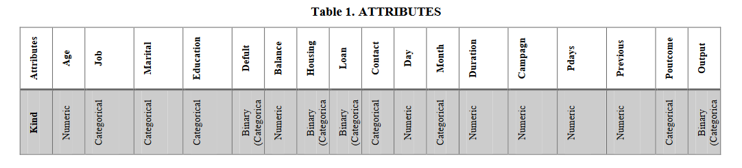
Problem definition
The bank marketing dataset contains data collected from a Portuguese bank regarding telemarketing campaigns for selling long term deposit accounts.
The data set contains 17 attributes and 45211 rows
Object is to predict if the client will subscribe a term deposit

Slide 3
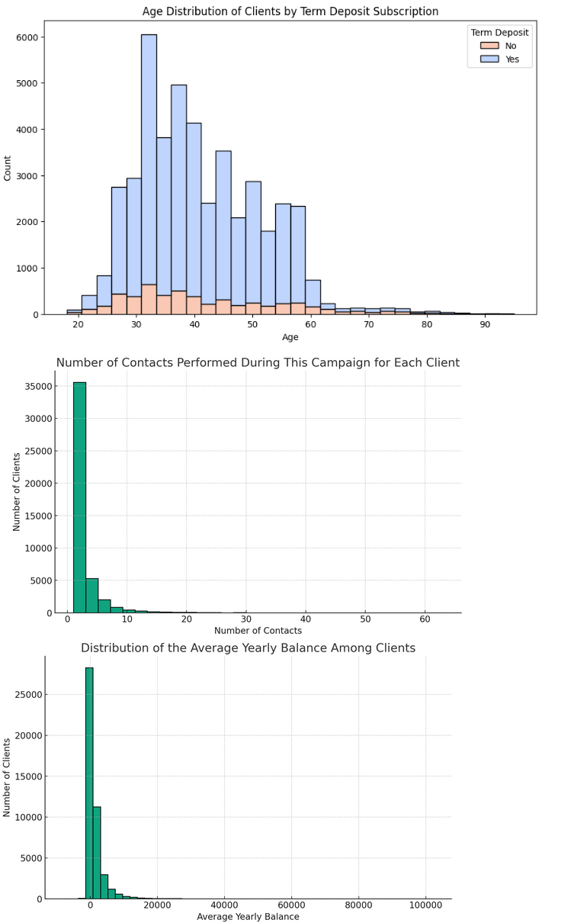
EDA
Age:indicates that consumers between the ages of 30 and 40 are more likely to subscribe to term deposits
Campaign: It shows that most clients are contacted a few times, with the frequency of contacts quickly decreasing as the number of contacts increases.
Balance: The distribution is right-skewed, indicating that while most clients have relatively low balances, a few clients have significantly higher balances.

Slide 4
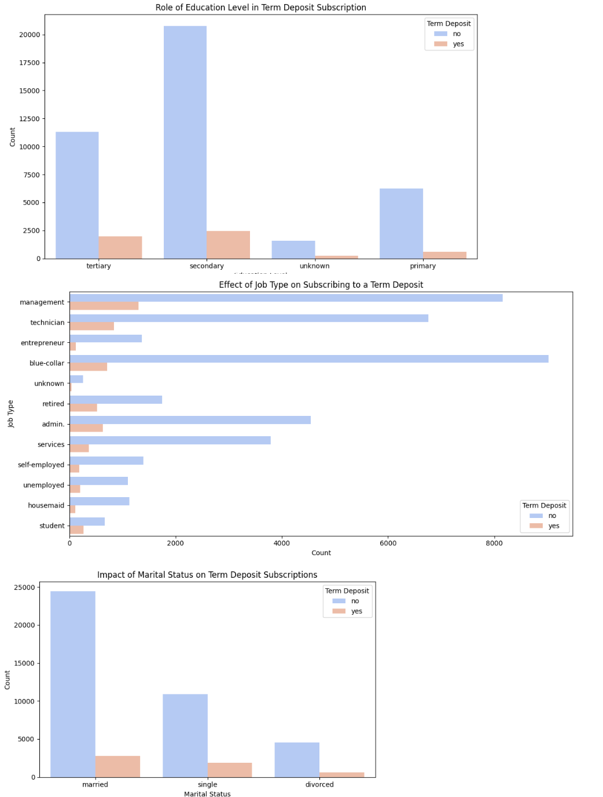
EDA
Education: The bar chart indicates clients with secondary education had a lower proportion of term deposit subscriptions compared to those with tertiary education.
Job: The horizontal bar charts indicates that individuals in management position are more likely to subscribe to term deposits
Martial: Married clients have the highest count to not to subscribe.

Slide 5
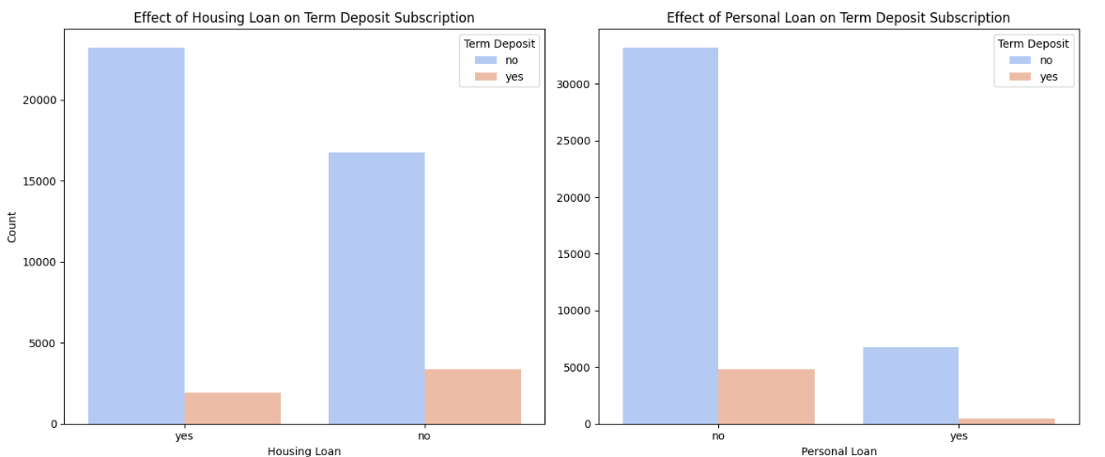
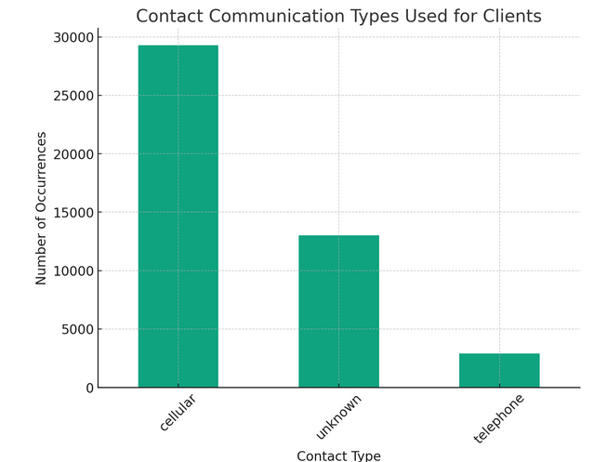
EDA
Housing loan: customers without housing loans tend to subscribe to term deposits more frequently than those with housing loans
personal loan: the analysis shows a higher subscription rate to term deposits among customers without personal loans.
Contact : It shows the frequency of each type, revealing the cellular method are most used.

Slide 6
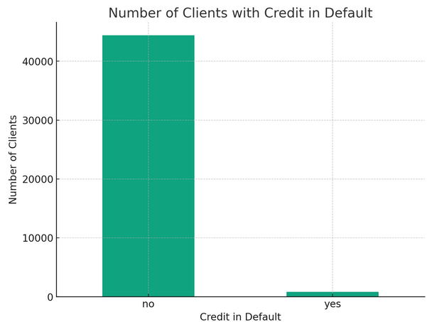
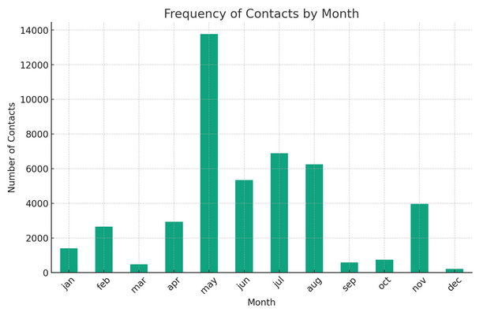
EDA
Default: It appears that a vast majority of clients do not have credit in default.
Month :The Contact Month Distribution plot highlights the months in which clients are most frequently contacted

Slide 7
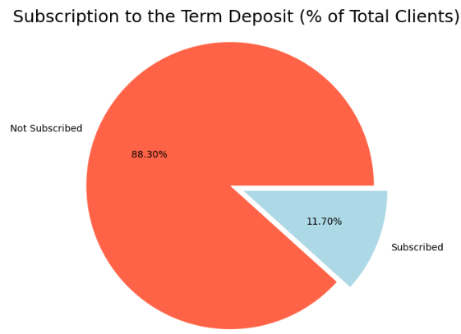
EDA
Desired target (Y):
The pie chart distinctly highlights the disparity between customers who have subscribed to a term deposit and those who have not.

Slide 8
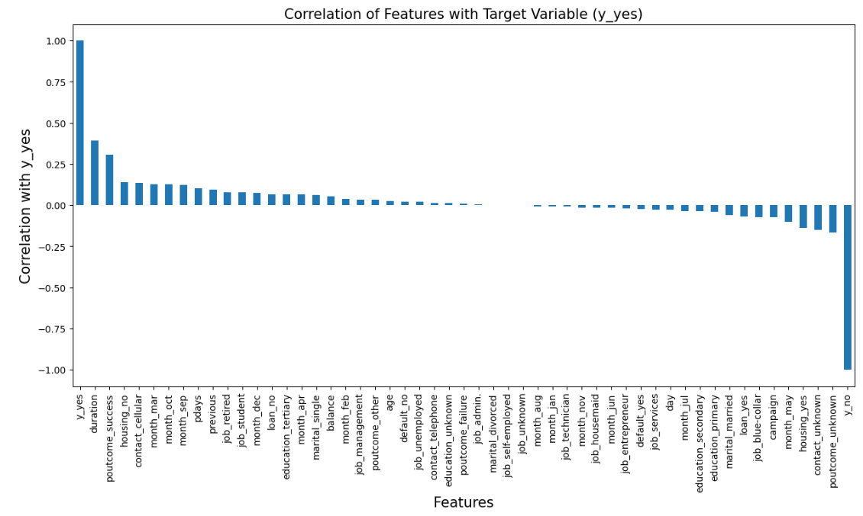
Correlation of feature with target variable

Slide 9
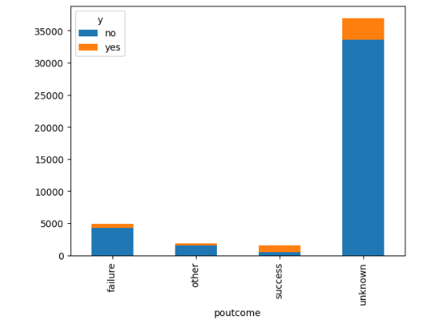
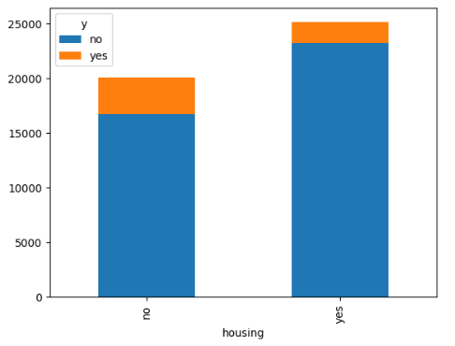
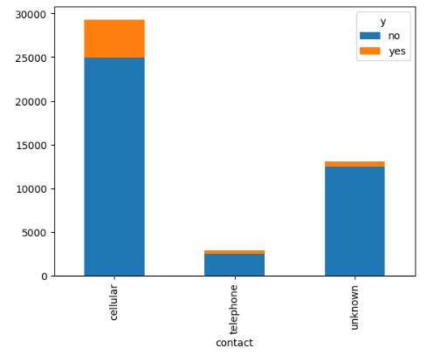
Exploring Attribute Correlations with Target Variables

Slide 10
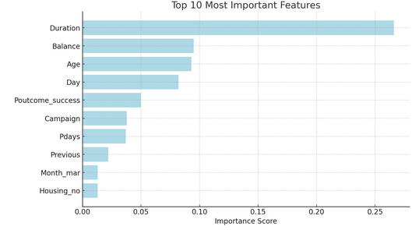
Top 10 important attributes

Slide 11
Evaluation
This study employs cross-validation techniques to assess the performance of classification models, utilizing a comprehensive approach to ensure the reliability and accuracy of the evaluation process. Three distinct algorithms are employed for this purpose:
1) Logistic Regression, known for its efficiency in binary classification problems and ability to provide probability scores for outcomes;
2) Support Vector Classifier (SVC), which is effective in high-dimensional spaces and is capable of performing linear and non-linear classification;
3) K-Nearest Neighbors (KNN), a simple yet powerful algorithm that classifies samples based on the majority vote of their neighbors. By applying these algorithms, the study aims to identify the most effective model for predicting outcomes, taking into account the nuances of the dataset and the inherent characteristics of each classification technique.

Slide 12
Conclusion
Based on the results obtained from cross-validation, it appears that Logistic Regression achieved the highest mean accuracy score of 81.34%, followed by Support Vector Classifier (SVC) with a mean accuracy of 73.32% and K-Nearest Neighbors (KNN) models achieved mean accuracies of 64.96%, respectively. These results suggest that Logistic Regression might be more suitable for this classification task compared to SVC and KNN.

Slide 13
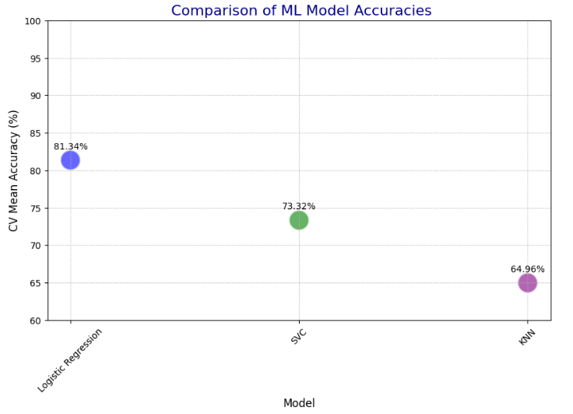
Machine learning

Slide 14
TOOLS USED
Programming language : python
Environment : google collab

Slide 15
The End

